Slide 1
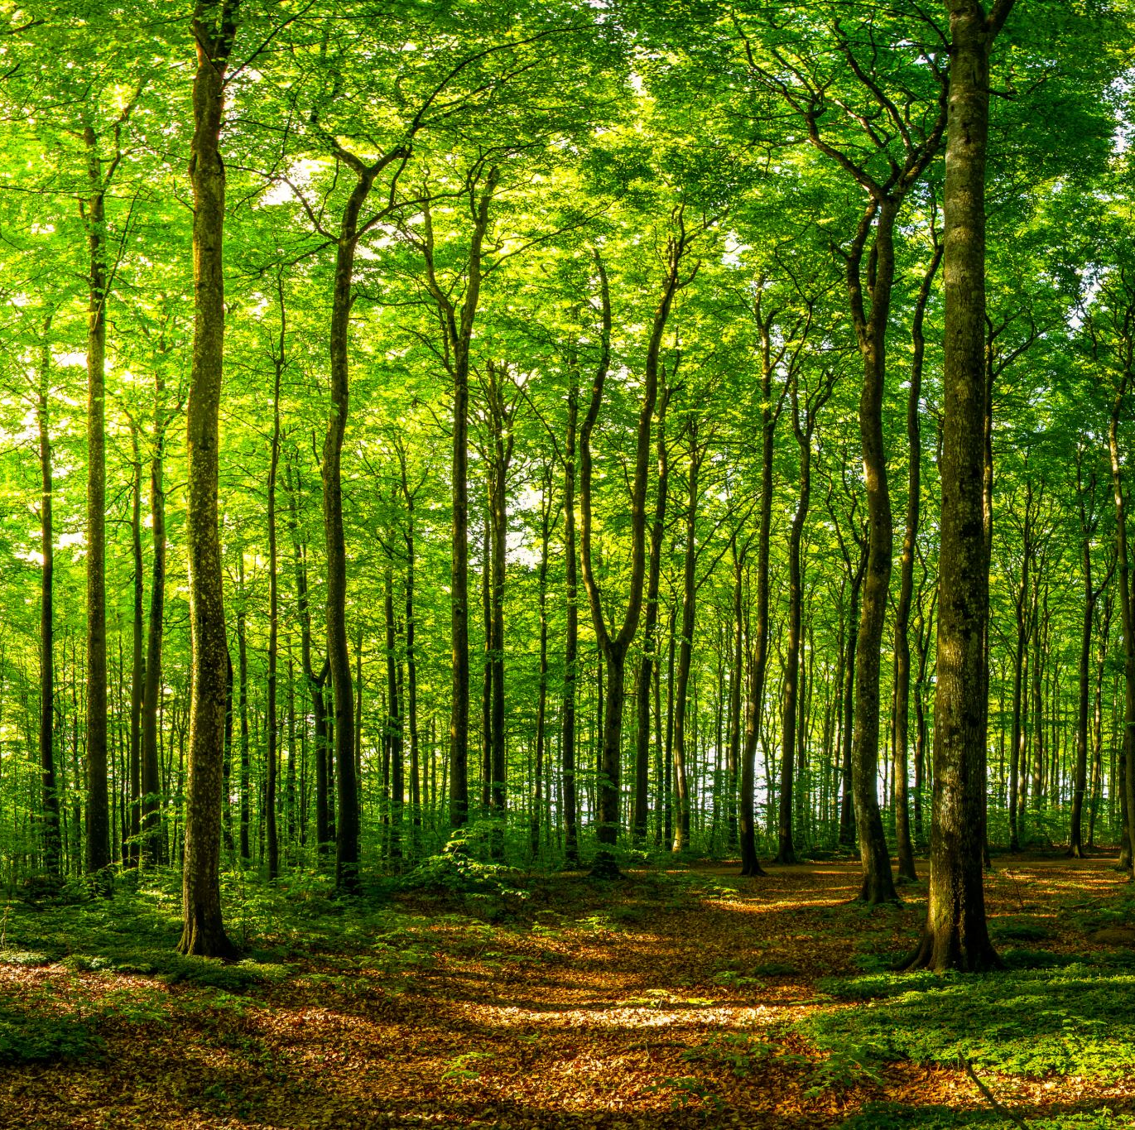
Random Forest
Simply Explained

Slide 2
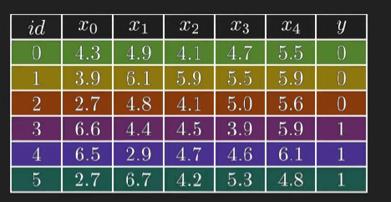
Let’s take a small dataset like this, x0, x1..x4 are features and y is the target variable
Since y takes either 0 or 1 values, it is a Binary Classification Problem

Slide 3
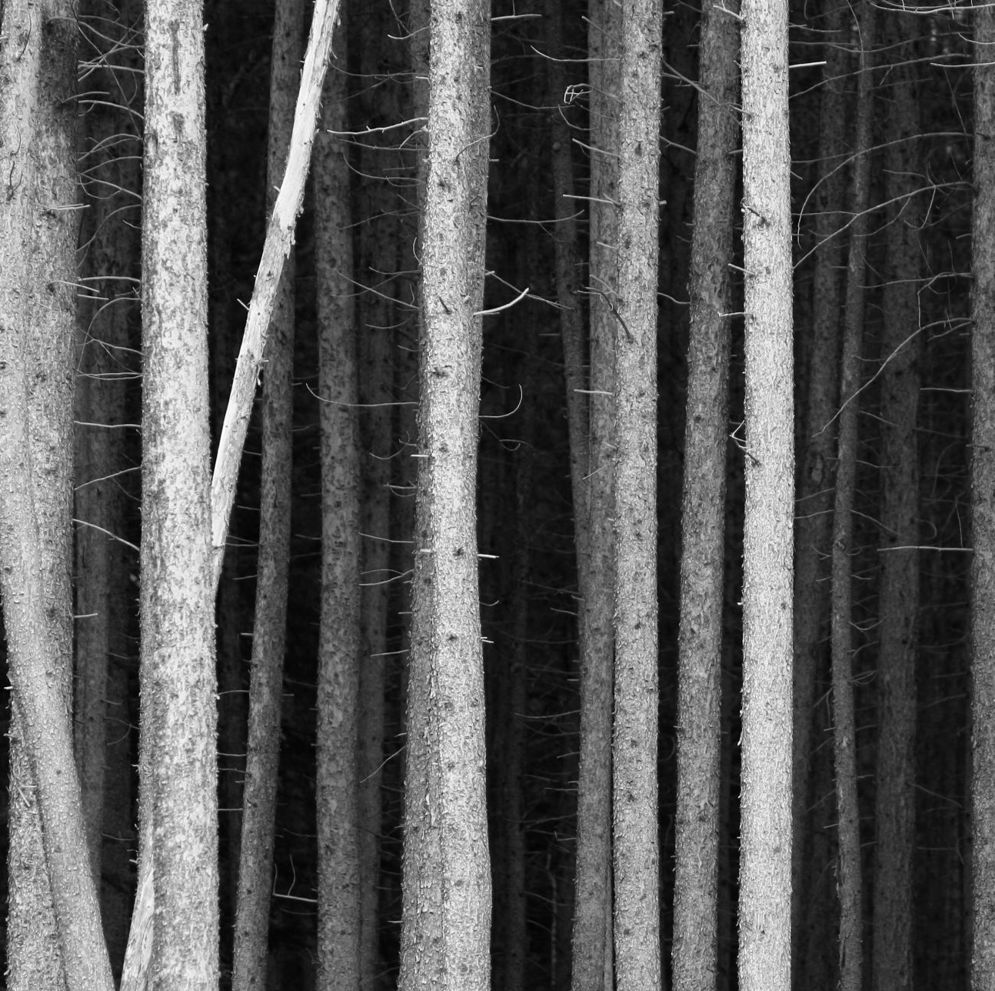
But, why do we need a Random Forest when we already have a Decision Tree?

Slide 4
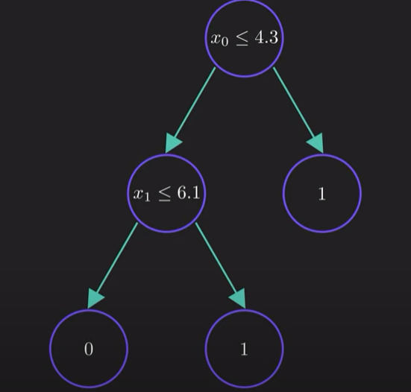
Let’s create a Decision Tree for our data

Slide 5
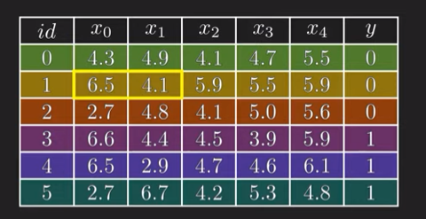
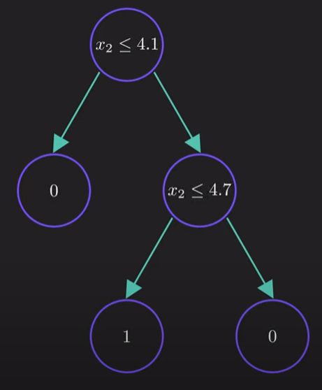
If we change our data a bit, we get a completely different tree

Slide 6

This means Decision Trees are highly sensitive to training data
So, our model may fail to generalize as it has high variance

Slide 7

How Random forest solves the problem?

Slide 8
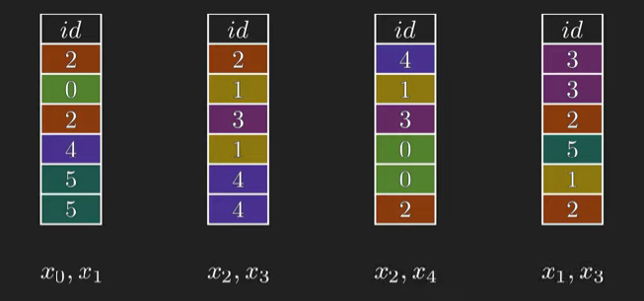
We will randomly create new data sets (generally ~ 100) from our original data sets and assign fewer features to those subsets (generally sq.root (total features))

Slide 9
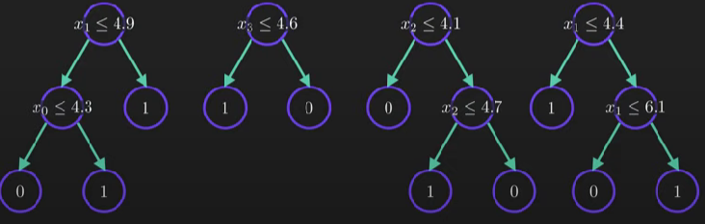
Lets create the trees

Slide 10
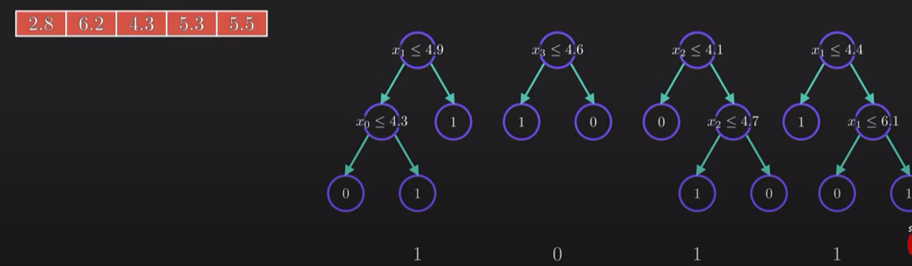
Now, lets have a new data point whose target variable is to be predicted
We will check each Decision Tree and note down the respective predictions
Majority Prediction is 1, so our dataset belongs to Class 1

Slide 11

So, in a Random Forest, we do two things – Bootstrapping and Aggregation (Bagging)
1. Bootstrapping : Bootstrapping is a resampling technique in which multiple subsets (samples) are created by randomly drawing with replacement from the original dataset.
2. Aggregation : Aggregation refers to the process of combining the predictions from multiple models to produce a final prediction.

